Slide 1



FINAL PROJECT PRESENTATION: INTRODUCTION TO DATA SCIENCE
UNLOCKING FINANCIAL FUTURES: A DIVE INTO ADVANCED LOAN PREDICTION STRATEGIES
TEAM 7
6 DECEMBER, 2023

Slide 2



THE LOAN MARKET
ABOUT THE DATASET
The loan market is vital to the financial system and Economy, categorized into secured/unsecured, open/closed-end, and conventional types.
The global Personal Loan market size was valued at $47.79 billion in 2020, and is projected to reach $719.31 billion by 2030
Global Student Loan market: $3.93 trillion in 2021, projected to reach $8.75 trillion by 2031 (8.7% CAGR).
Global Automotive Finance market: $259.84 billion in 2022, anticipated CAGR of 7.3% from 2023 to 2030.
Global Home Loan market: $4.52 trillion in 2021, projected to reach $33.3 trillion by 2031 (22.3% CAGR).
The global FinTech lending market size was valued at $449.89 billion in 2020 and is projected to reach $4,957.16 billion by 2030,
Sourced from Kaggle, our data comprises records of 4269 applicants related to the factors that the financial lending market considers when assessing loan applications.
The data has detailed information about each applicant’s employment status, annual income, asset values, loan amount, CIBIL score, and the number of dependents.
By analysing the existing trends gathered from this data, we aim to predict the probability of loan approval.
Evaluating financial histories and risk profiles, loan prediction models can assist lenders in tailoring loan terms to individual borrowers.
Faster and more accurate loan approval processes contribute to a highly improved customer experience.

Slide 3
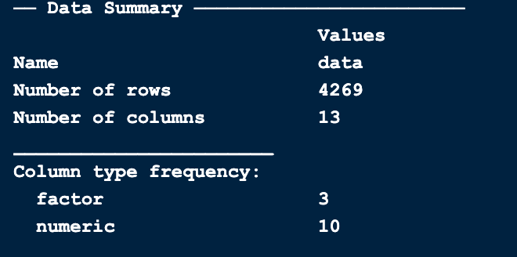
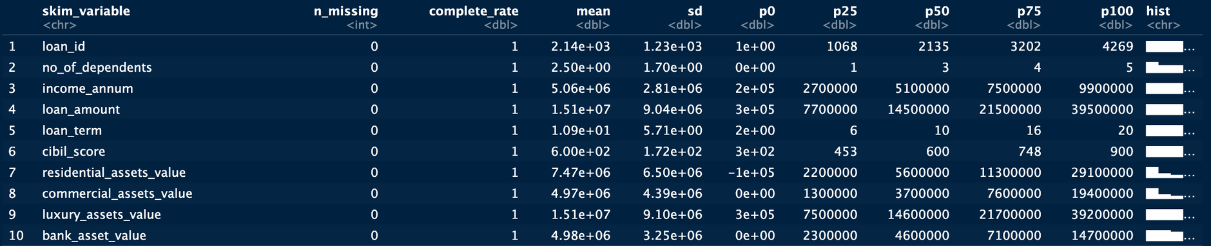

AN OVERVIEW OF THE DATA
There are 13 columns in our data, of which 3 are of factor type and 10 are of numeric type.
Integer Variables
Character Variables

Slide 4


Exploratory Data Analysis

Slide 5
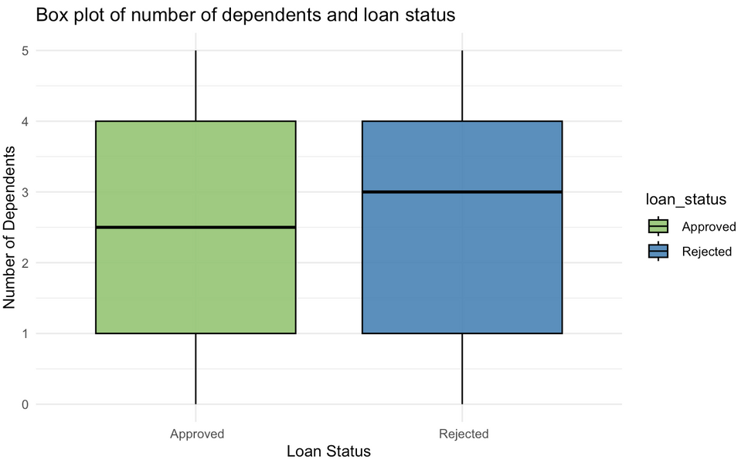
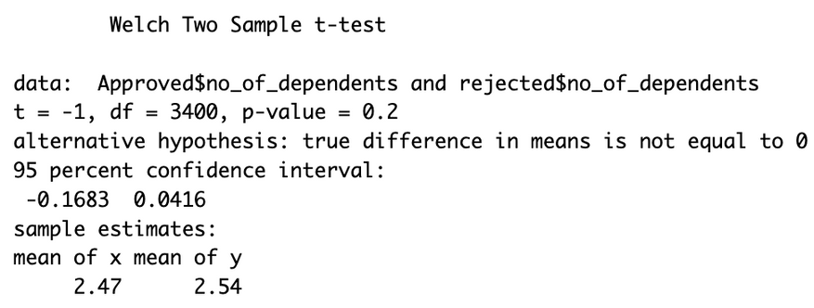
ANALYSIS OF THE NUMBER OF DEPENDENTS
What is the impact of the number of dependents on the likelihood of loan approval?
The boxplot illustrates that the number of dependents of the applicant has no significant effect on the probability of loan approval.
There is only a slight deflection in the Median.
In this Welch Two Sample t-test,
H0: Number of dependents has no significant association with loan approval/rejection.
HA: Number of dependents has significant association with loan approval/rejection.

Slide 6
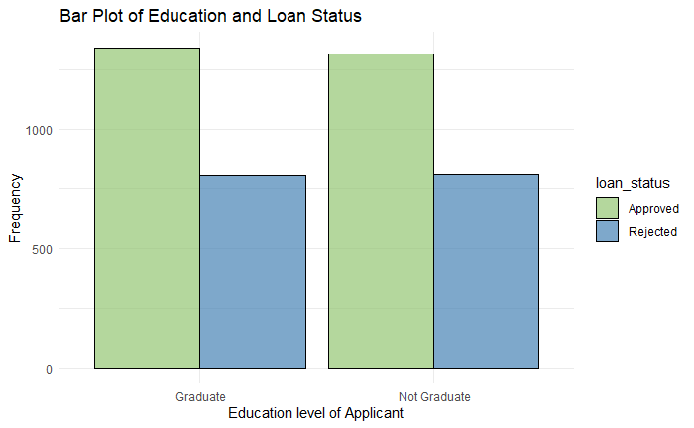
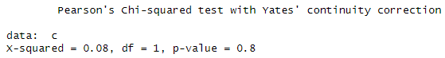
INFLUENCE OF EDUCATION ON LOAN APPROVAL
Is there a significant difference in loan approval for different education levels and loan
terms?
The bar plot depicts the impact of education on loan approval, revealing a surprising finding.
There is minimal distinction between graduates and non-graduates in terms of loan approval or rejection, as both groups exhibit nearly identical proportions.
This indicates that education may not be a decisive factor influencing loan approval.
In this Welch Two Sample t-test,
H0: There is no significant association between education level and the loan status.
HA: There is significant association between education level and the loan status.

Slide 7
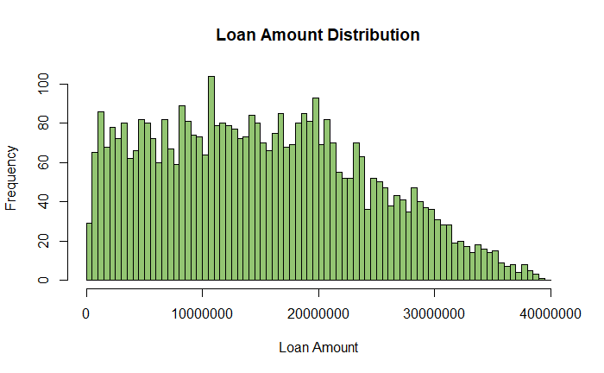
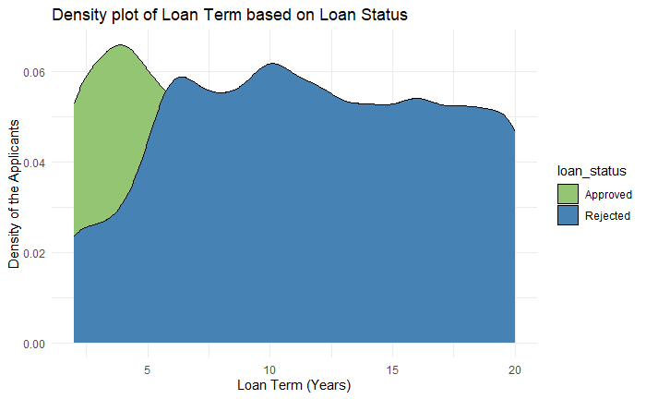
LOAN AMOUNT AND LOAN TERM
The histogram illustrates a range of loan amounts from 0 to 40,000,000, indicating a decline in the number of applicants as loan amounts increase.
The majority of applicants fall within the range of 0 to 20,000,000.
The density plot reveals a distinct pattern in loan approval/rejection based on the loan term. Notably, applications with a term of 0-5 years exhibit the highest approval rate, while those with a term exceeding 5 years tend to face rejections.
This pattern suggests a lending strategy focused on approving individuals capable of immediate repayment.

Slide 8
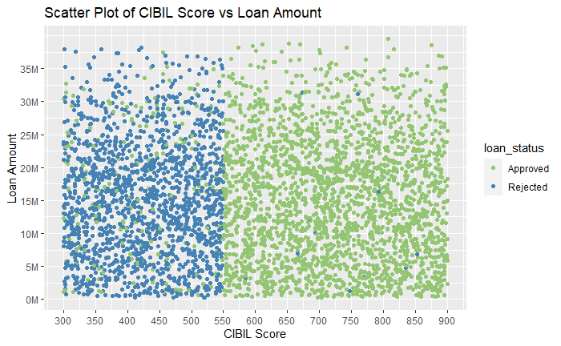
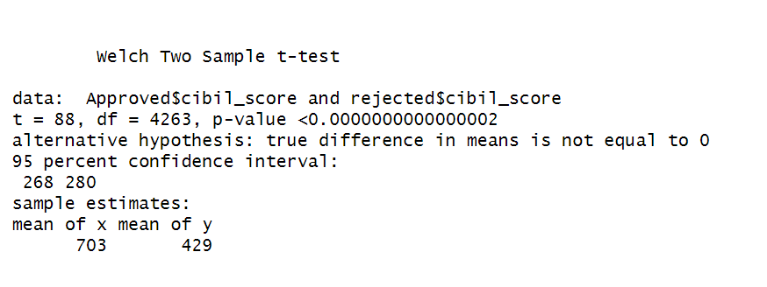
IMPACT OF CIBIL SCORE
Is there a significant difference in loan approval for different CIBIL scores?
The scatter plot displays a clear relationship between loan amount and CIBIL score. Rejections are predominantly observed within the CIBIL score range of 300-550. Approval rates surge beyond a CIBIL score of 550, even for loan amounts surpassing 35M.
Notably, within the CIBIL score range of 330-550, some approvals are present, indicating the influence of other factors on approval decisions in this specific score range.
In this Welch Two Sample t-test,
H0: CIBIL score has no significant association with the loan status.
HA: CIBIL score has significant association the loan status.

Slide 9
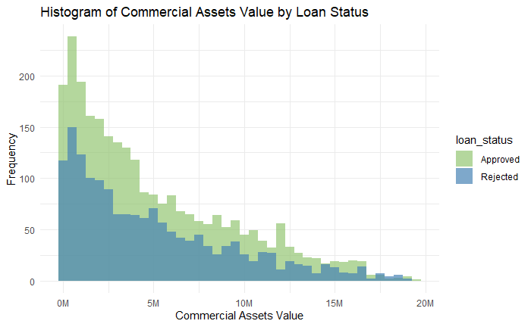
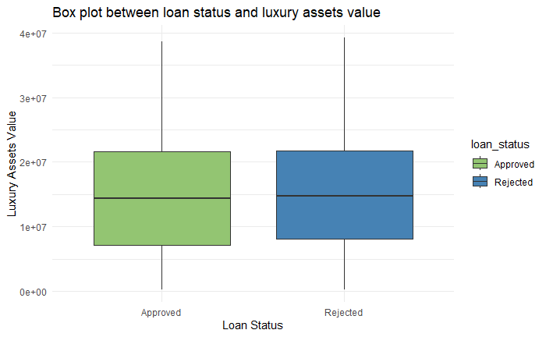
ANALYSIS OF VARIOUS ASSETS
Is there a notable difference in residential and commercial asset values between approved
and denied loan applications?
The histogram depicts a positive correlation between individuals possessing favorable commercial values and a higher likelihood of loan approval.
Conversely, as the loan value increases, the number of applicants diminishes. The majority of applicants fall within the 0-5 million range.
The box plot reveals that approved loans tend to have Luxury Assets Value concentrated around 0.85M to 2.2M, with a median near 1.5M, while rejected loans show a range from 0.9M to 2.15M, with a median at 1.5M, suggesting a comparable central tendency but with differing spread.

Slide 10
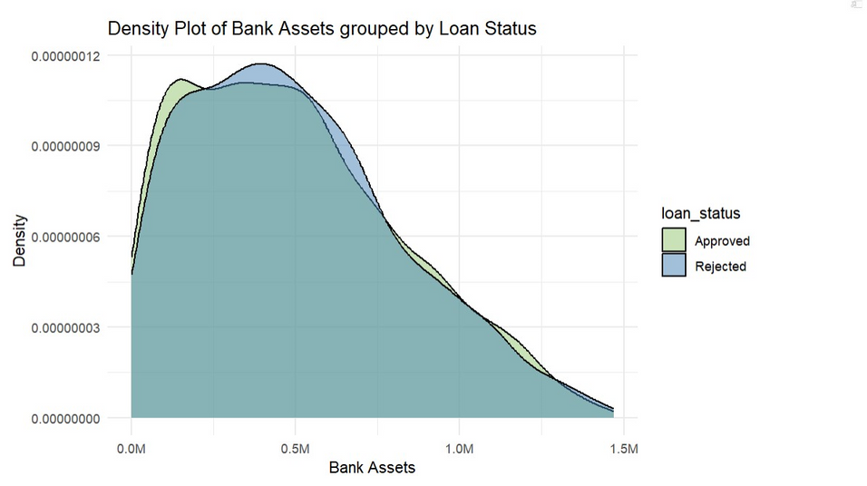
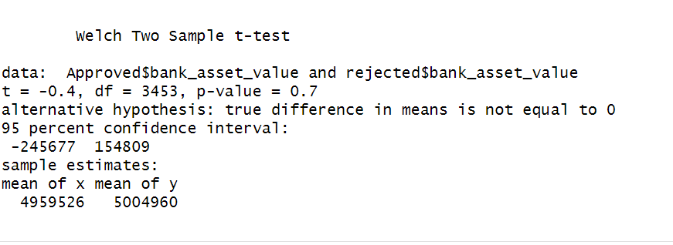
ANALYSIS OF BANK ASSETS
The density plot shows that the bank asset value doesn’t affect loan status of the applicants.
In this Welch Two Sample t-test,
H0: Bank asset value does not have significant association with the loan status
HA: Bank asset value has significant
association the loan status.

Slide 11
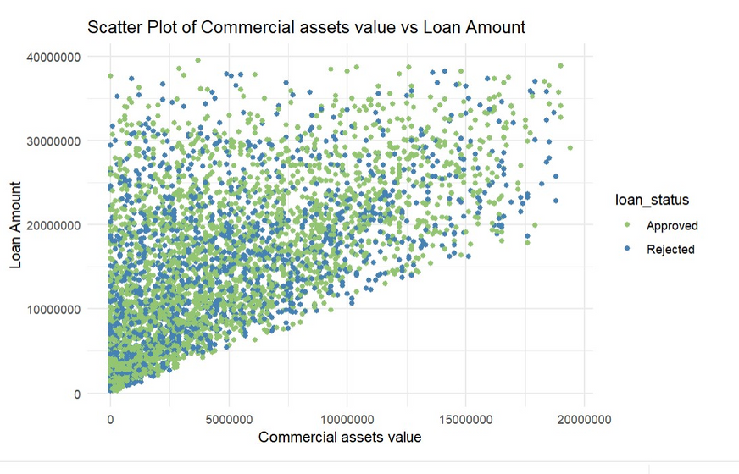
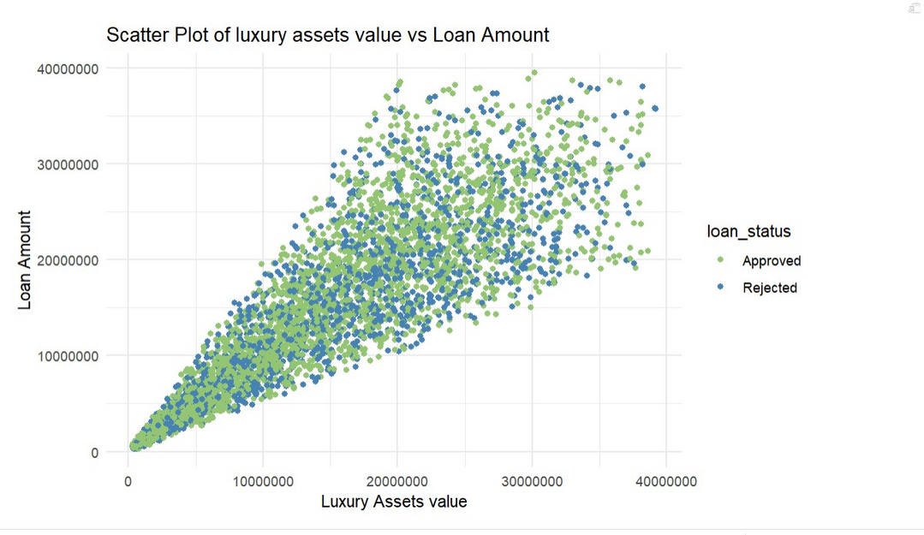
ANALYSIS OF ASSETS
According to the graph, the higher the commercial asset value, higher is the loan amount.
Approvals and rejections have similar distribution, hence the approval and rejection rates are same in case of commercial assets value and loan amount.
Based on the graph, there is a positive correlation between luxury asset value and loan amount, indicating that as luxury asset value increases, so does the loan amount.

Slide 12
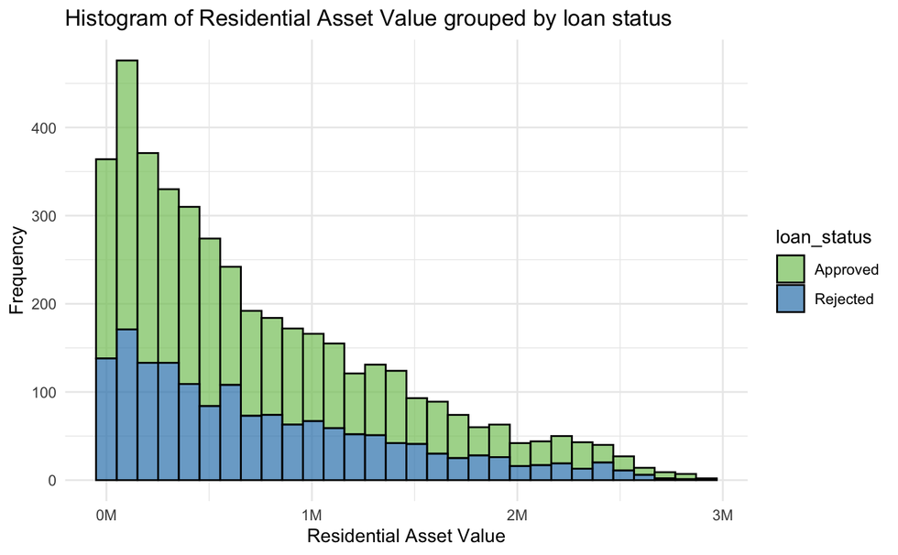
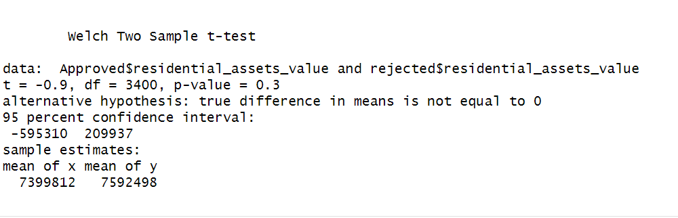
ANALYSIS OF ASSETS
From the histogram, it can be assessed that at all of the ranges of the residential assets value, the approval and the rejection rate are almost the same.
Even with the increasing range, the distribution also remains the same.
In this Welch Two Sample t-test,
H0 -> Residential Asset value does not have significant association with loan status.
HA -> Residential Asset value has significant association with the loan status.

Slide 13
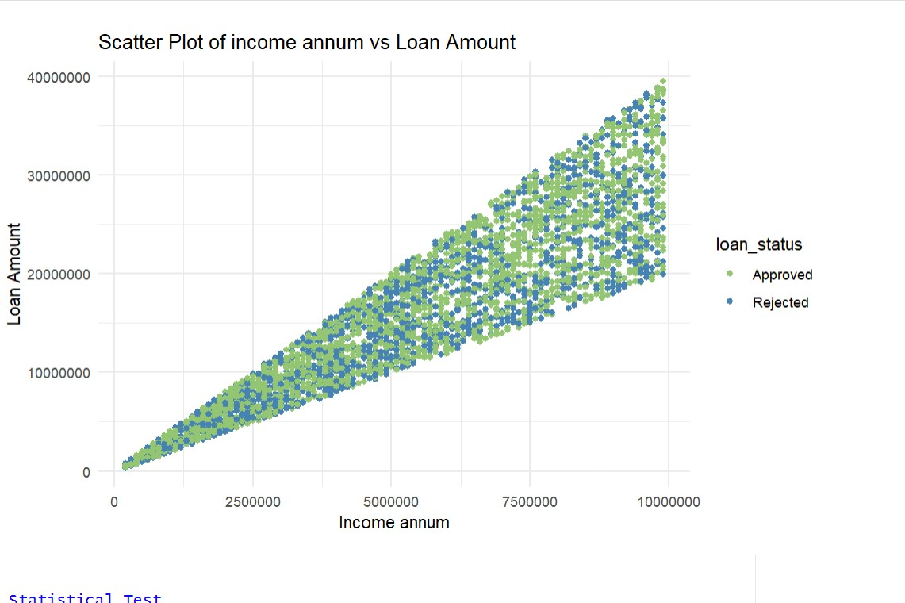
ANALYSIS OF INCOME
The graph illustrates a direct correlation between annual income and loan amount, implying that an increase in annual income corresponds to a higher loan amount.
Furthermore, the distribution of approvals and rejections seems comparable, indicating that approval and rejection rates remain consistent across different levels of annual income and loan amount.

Slide 14

FEATURE SELECTION

Slide 15
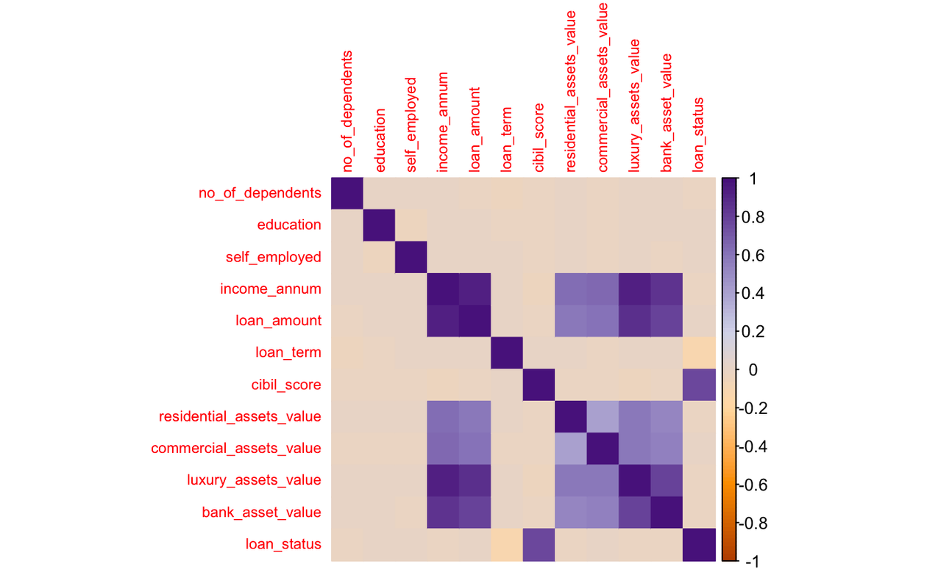
CORRELATION ANALYSIS
Which is the single most influential factor in determining the probability of loan approval?
This correlation plot illustrates that the variable ‘cibil_score’ has the highest correlation to our target column, ‘loan_status’.
Additionally, the ‘loan_amount’ also showcases high correlation to the assorted asset values.

Slide 16
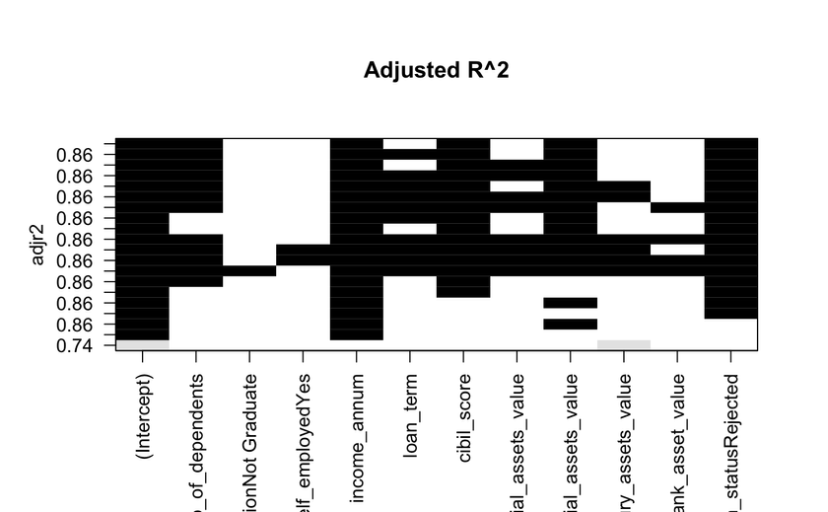
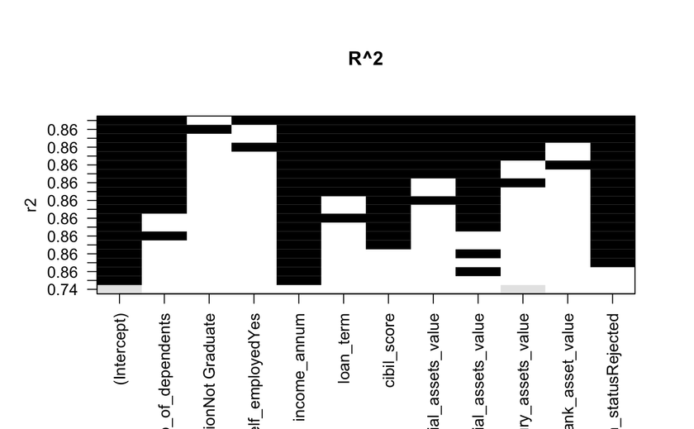
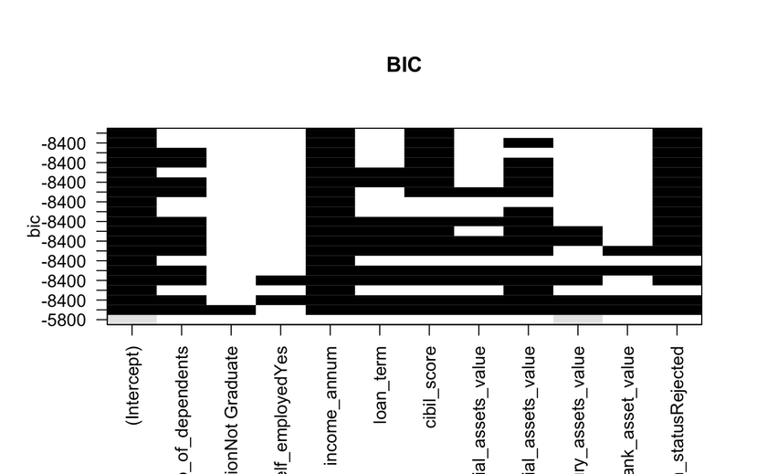
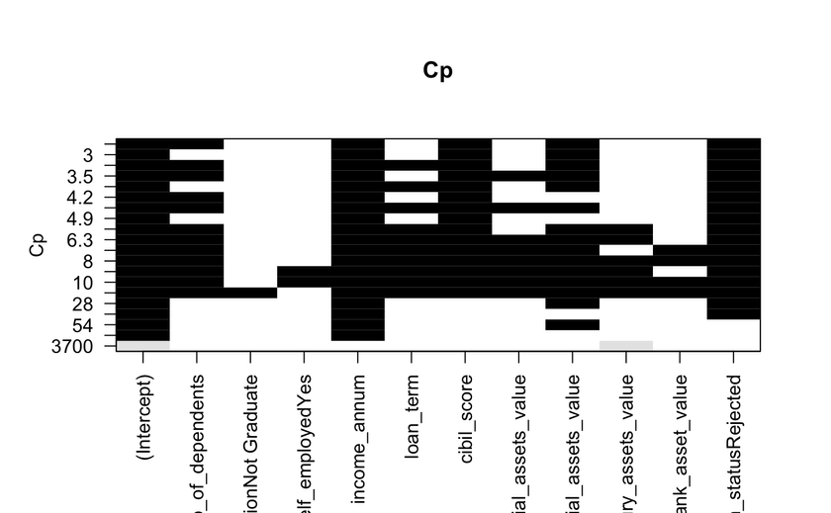
BEST PREDICTORS USING ‘LEAPS’
The ‘regsubsets()’ selection method: Adjusted R-squared (adjr2), R-squared (r2), Bayesian Information Criterion (BIC), or Mallows' Cp.
Used to find the best subset of predictor variables that minimizes or maximizes a chosen criterion.
Based on our analysis of these plots, the best predictors from the 13 total variables are found to be -‘no_of_dependents’, ‘loan_term’, ‘income_annum’, ‘commercial_assests_value’ and ‘cibil_score’.

Slide 17
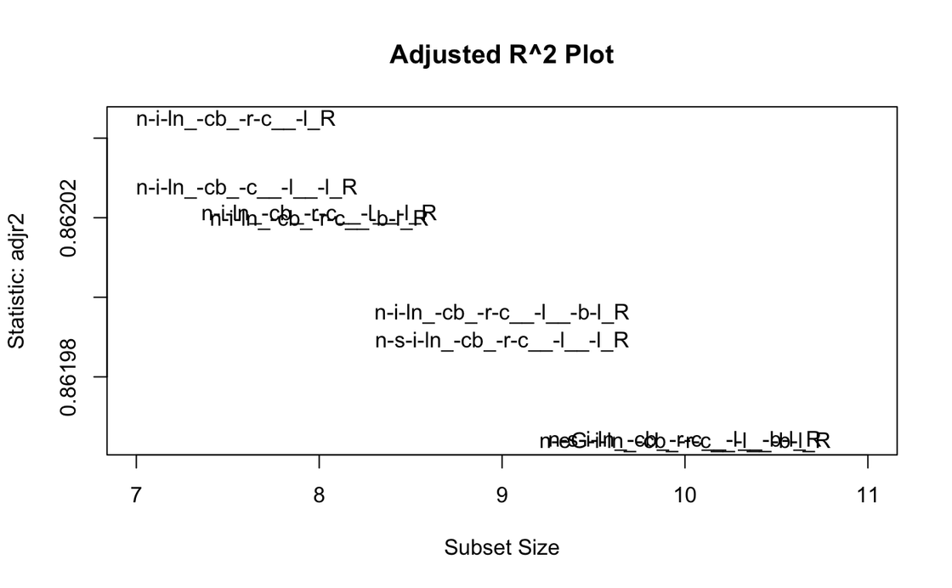
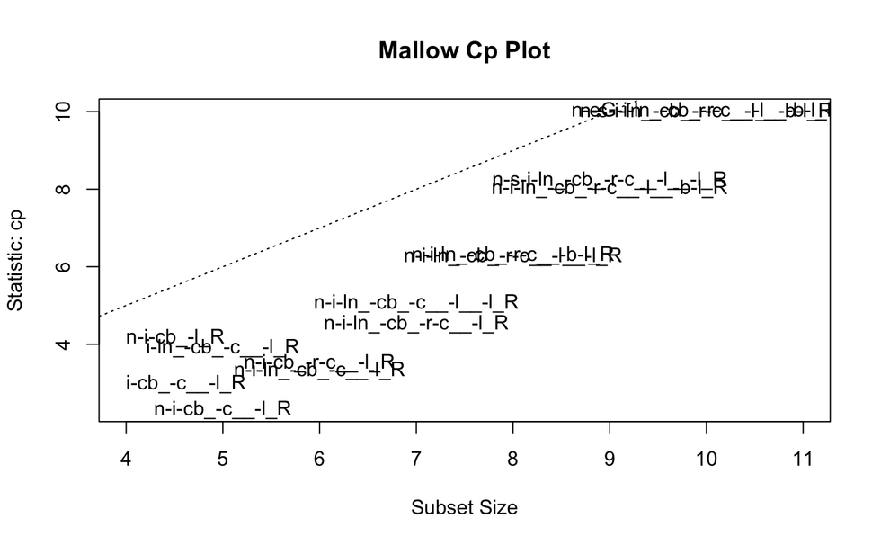
ADJ. R² AND MALLOW CP ANALYSIS
Based on the Adjusted R² plot above, it can be said that if we select no_of_dependents, loan_term, income_annum, cibil_score, commercial_assests_value and luxury_assests_value, we’ll achieve the highest adjusted R² value.
Based on the Cp Mallow plot above, it can be said that if we select no_of_dependents, loan_term, income_annum, cibil_score, commercial_assests_value, and luxury_assests_value, we’ll achieve the lowest Mallow Cp value.

Slide 18
DATA MODELLING

Slide 19
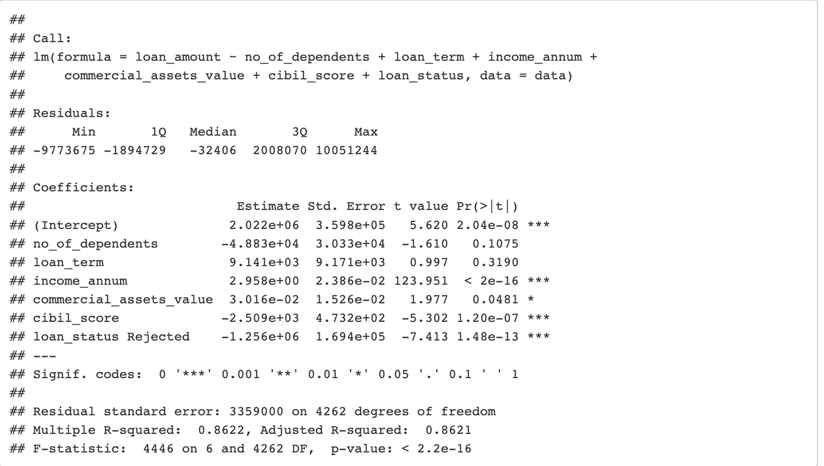
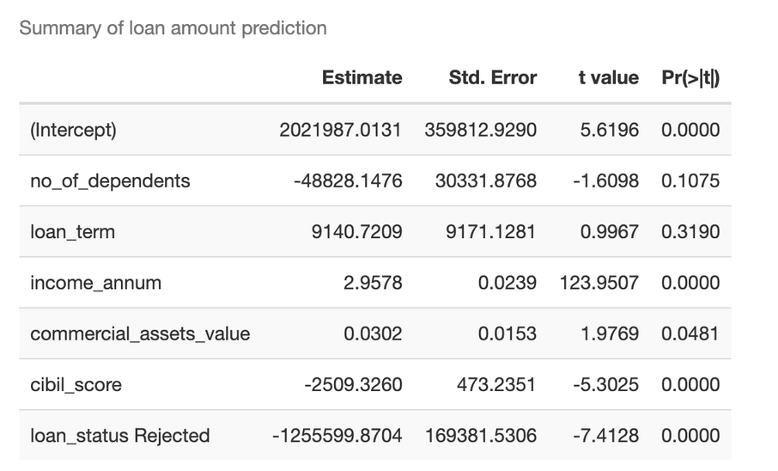
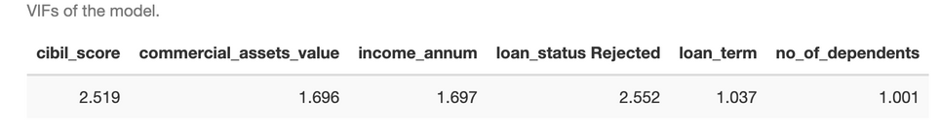
LINEAR REGRESSION MODEL: PREDICTION OF LOAN AMOUNT
Can the loan amount be predicted based on the values of assets and annual income?
The model shows that we are getting an adjusted R² value of 0.862 which means that the model explains 86.2% of the variance of the data.
The equation for the linear model to predict loan amount:
loan_amount=2021987.0131-48828.1476*no_of_dependents+9140.7209*loan_term+2.9578*income_annum+0.0302*commercial_assets_value-2509.3260*cibil_score-1255599.8704*loan_status
By looking at the VIF (Variance Inflation Factor) values we can say that all of the VIF values are less than 3 which means that there is no multicollinearity.

Slide 20
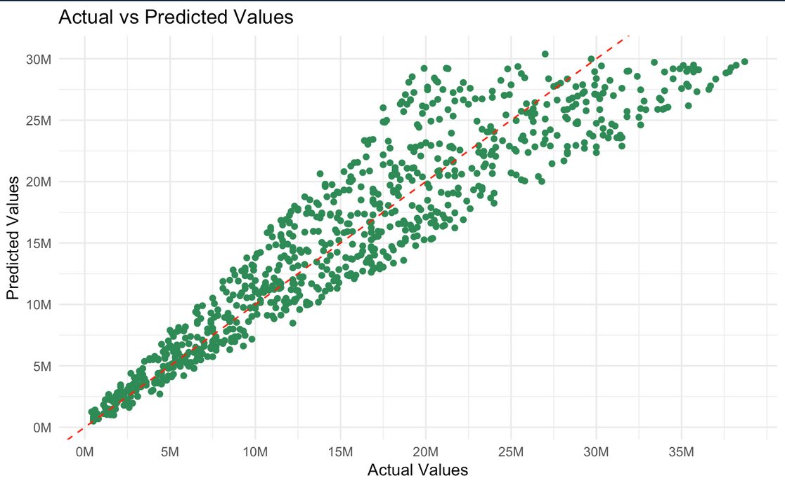
LINEAR REGRESSION MODEL: ACTUAL VS PREDICTED
The red line in the above plot represents the predicted instances and the green points show the actual points. By looking at the graph we can say that the predicted line is a nice fit in this model.

Slide 21
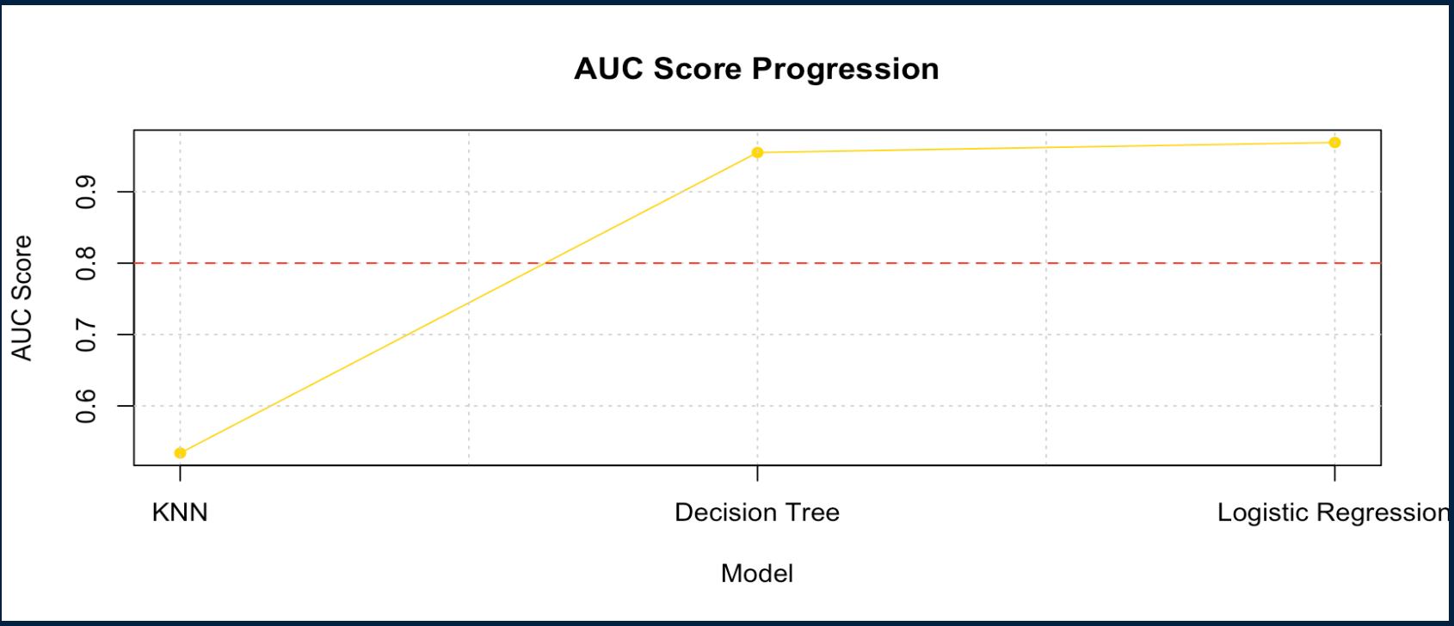
CLASSIFICATION MODELS
LOGISTIC REGRESSION
KNN
DECISION TREE

Slide 22
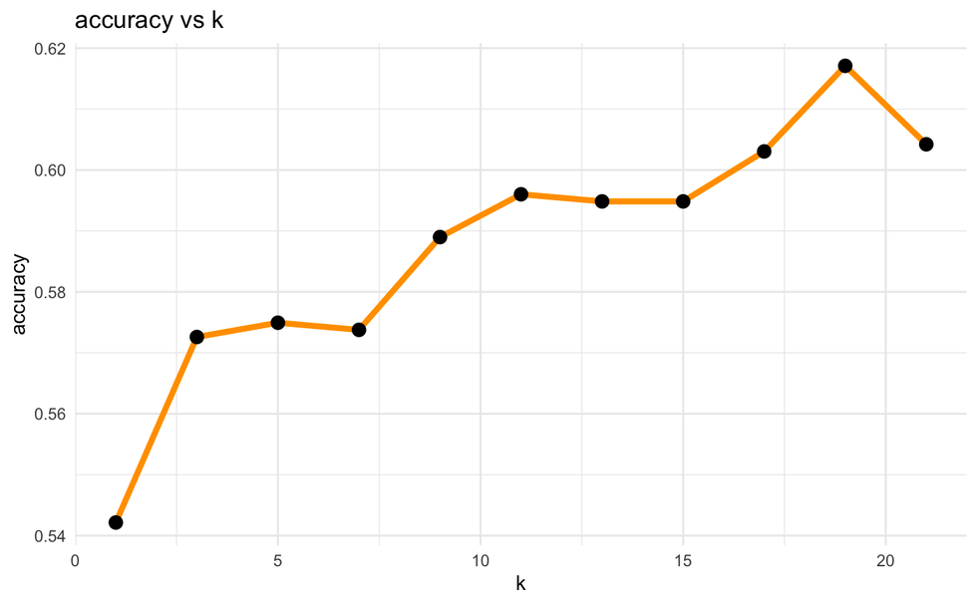
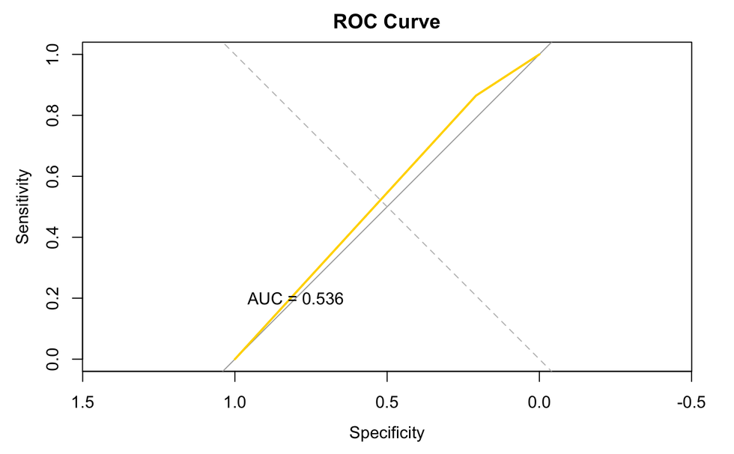
K-NEAREST NEIGHBORS ANALYSIS
According to the ‘Accuracy vs k’ graph, it is evident that the highest accuracy can be achieved when ‘k’ is set to 18.
Based on the ROC curve that we obtained, the AUC score is 0.536, indicating our data is not a good fit for this model.

Slide 23
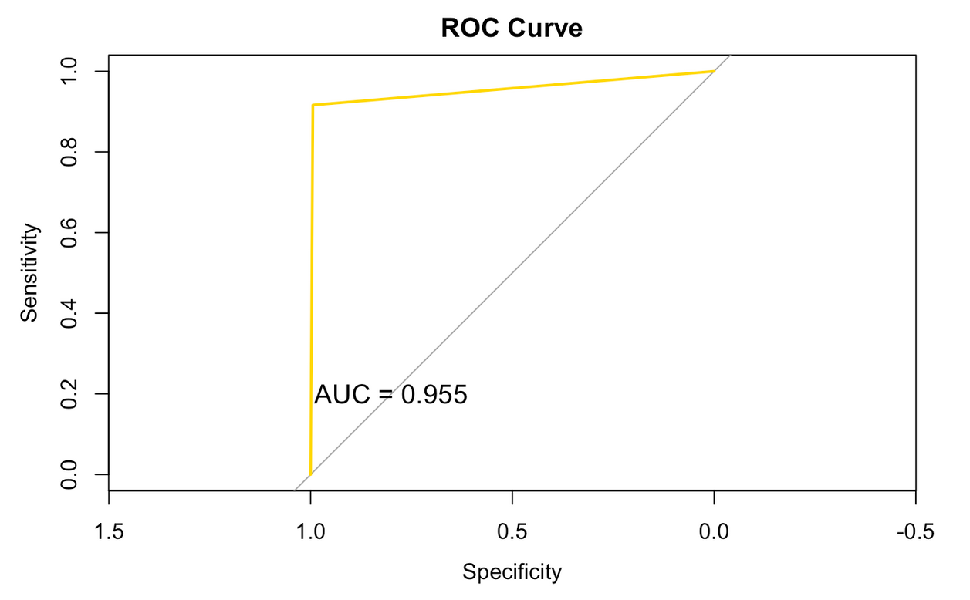
DECISION TREE IMPLEMENTATION RESULTS
The area under the curve of our decision tree model is 0.955, which indicates that our model is a good fit.

Slide 24
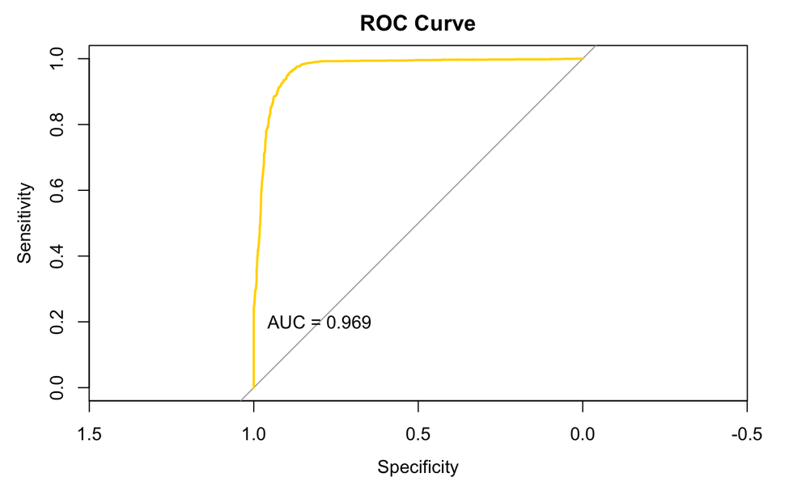
LOGISTIC REGRESSION ANALYSIS
The area under the curve of our logistic regression model is 0.969, which indicates that our model is a good fit.

Slide 25
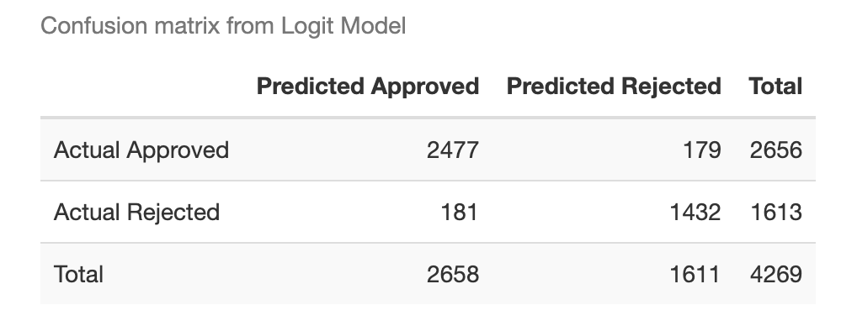
LR PREDICTION METRICES
The correctly predicted instances are 3909. The false negatives are 179 and false positives are 181.
Along with this we found out that the Precison and Recall are 95% and 99%

Slide 26
CONCLUSION
A thorough analysis of factors influencing loan approval reveals that an applicant's approval, measured by the CIBIL score, is the primary determinant of loan status, exhibiting a robust correlation with positive outcomes.
Through several feature selection techniques, we were able to determine the most important factors that influence the likelihood of loan approval. Therefore, an applicant can emphasize the most on those aspects during loan application for a greater chance of success.
We have used prediction models to determine the loan status (logistic regression, decision tree and KNN) and loan amount (linear regression).
This comprehensive exploration offers valuable insights for both applicants and lending institutions, guiding prospective borrowers to focus on maintaining a favorable credit score, considering their assets, and aligning loan preferences with financial goals, while lending institutions can optimize decision-making processes and provide tailored financial solutions based on these findings.

Slide 27
WE WANT TO SAY
THANK YOU
FOR YOUR ATTENTION
ANY QUESTIONS?

